Slide 1
Advanced Databases Introduction
Dr. Pierpaolo Dondio,
DT228/4

Slide 2
Lecturer & Timetable
Dr. Pierpaolo Dondio
Office: K115 (first floor main building)
Email: pierpaolodondio@dit.ie
Class: Monday 11-13, room B-016
Labs: Monday 9-11
Starting from Week 2

Slide 3






Why this is the most important course (ever).
Jobs
Good Outlook
Strategic to Ireland
More jobs than DB experts
Highly wanted:
DBA
Data Analyst
ETL Expert
Business Intelligence
Some brands active in Dublin

Slide 4
Content in a nutshell
ER Diagram Revision – yet again! [15%]
Advanced Topics: DB Design, RAID, Optimization, Indexes, Concurrency, Transactions [25%]
Database Integration and Data Warehouse [30%]
NoSQL Systems, Neo4j, Hadoop, MongoDB
[30%]

Slide 5
Assessment Methods
CA – 40%
Lab work is graded (via demos)
Short assignment on DW and NoSQL
1 Lab Quiz
TO BE CONFIRMED
Written exam – 60%
Exam papers will be available on webcourses

Slide 6
The SQL Way
Solid (theoretically and practically)
A lot of things are guaranteed
Keys, constraints, relations, query language…
DBMS is a monster of complexity
The 4 magic properties of Relational Database (Oracle/Mysql,SQL Server…)
Atomic
Consistency
Isolation
Durability

Slide 7
The NOSQL way
BASE
Basically Available
Soft-state
Eventually consistent
Why?
Need to scale horizontally!

Slide 8
Some introduction
Who/what takes care of my data?
Application
NOSQL
SQL
DB Layer
Operating Systems
Physical Disk

Slide 9
Book and Resources
Fundamentals of Database Systems -5th Ed,Elmasri & Navathe(Main Book)
Database Systems -4th Ed. Connolly & Begg (Good book for introduction and advanced topics)
Various research papers
Web
SQL: http://www.w3schools.com/sql
SQL: http://www.sqlzoo.com/

Slide 10
And now….
Let’s review an old friend…
ER diagram
Relational Model
Normalization

Slide 11
Exercise 1 – A social network
How do you model in SQL the friend of relation among users?
Suppose each user is defined by name, surname, userid. The friend of relationship is not symmetrical in general
Create a relational model (=tables)

Slide 12
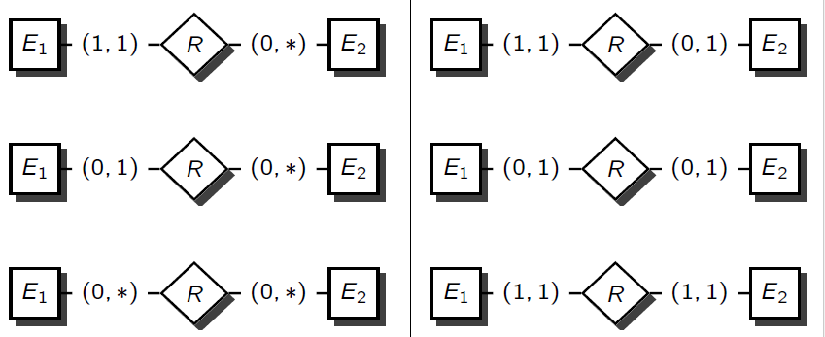

Exercise 2 – Can I do this?
Model one of the following relation with the required table representation and constraints
(1,*)
(1,*)

Slide 13
Exercise 3 - ER Design can be tricky
How do you model (relational model) a list of items where each items can have a different set of attribute?
And attribute can be added!
Example.
Toys with different attribute.
A car (=toy name) has attribute engine_size, maker
A teddy (=toy name) bear has attribute material,animal_type

Slide 14
A sensible solution
Toy - Description
Toy ID
Property ID
Value
Toy
Toy ID
Name
Description
Property ID
Name
How do you handle different data types?
More tables or all strings?

Slide 15
4th Year Projects
Data Analytics
Cultural Biases in Wikipedia
Analytics on Magic the Gathering Cards
Using StackOverflow as a teaching tool
Sport Predictions
Others
Personalized Apps for teaching Maths to Primary School Pupils

